Slide 1
Covid 19 Report

Slide 2
Transferring the dataset
Used WinSCP to transfer the csv dataset file
Used a shell command to change the line endings for the file

Slide 3
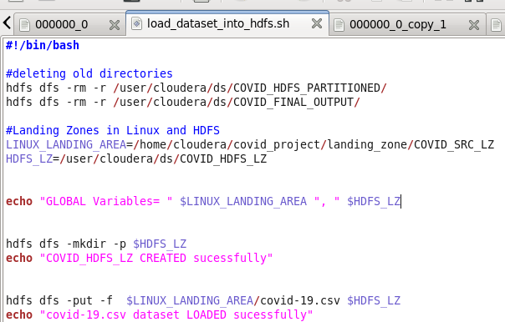
Transferring files to HDFS
Created the needed directories using shell command lines
Wrote a shell script that would transfer the dataset to HDFS

Slide 4

Hive Script
1. Setting some settings for Hive concerning memory

Slide 5
Hive Script
2. Hive table to load the dataset
CREATE TABLE IF NOT EXISTS covid_db.covid_staging
(
Country STRING,
…
Rank_by_Death_of_Closed_Cases DOUBLE
)
ROW FORMAT DELIMITED FIELDS TERMINATED by ','
STORED as TEXTFILE
LOCATION '/user/cloudera/ds/COVID_HDFS_LZ'
tblproperties ("skip.header.line.count"="1", "serialization.null.format" = "''");

Slide 6
Hive Script
3. Hive table that partitions the previous table
CREATE EXTERNAL TABLE IF NOT EXISTS covid_db.covid_ds_partitioned
(
Country STRING,
…
Rank_by_Death_of_Closed_Cases DOUBLE
)
PARTITIONED BY (COUNTRY_NAME STRING)
STORED as TEXTFILE
LOCATION '/user/cloudera/ds/COVID_HDFS_PARTITIONED'
tblproperties ("serialization.null.format" = "''");

Slide 7
Hive Script
4. Insert data from the first Table
FROM
covid_db.covid_staging
INSERT INTO TABLE covid_db.covid_ds_partitioned PARTITION(COUNTRY_NAME)
SELECT *,Country;

Slide 8
Hive Script
5. Hive table to generate the final report
CREATE EXTERNAL TABLE covid_db.covid_final_output
(
TOP_DEATH STRING,
TOP_TEST STRING
)
PARTITIONED BY (COUNTRY_NAME STRING)
ROW FORMAT DELIMITED FIELDS TERMINATED by ','
STORED as TEXTFILE
LOCATION '/user/cloudera/ds/COVID_FINAL_OUTPUT';

Slide 9
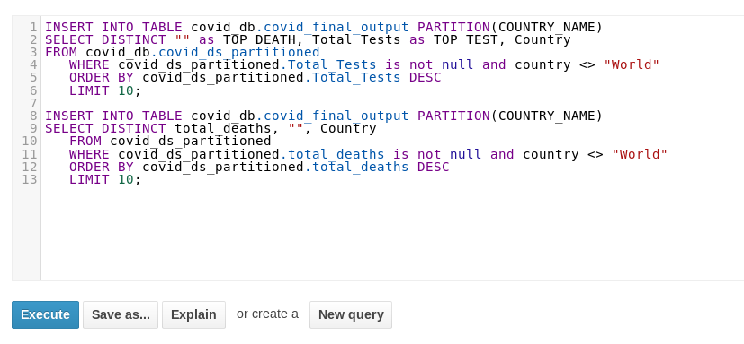
Hive Script
6. Inserting data into the report table

Slide 10
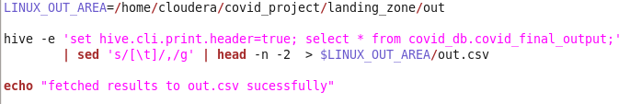
Final report file
7. Shell script to generate the report as a csv file

Slide 11
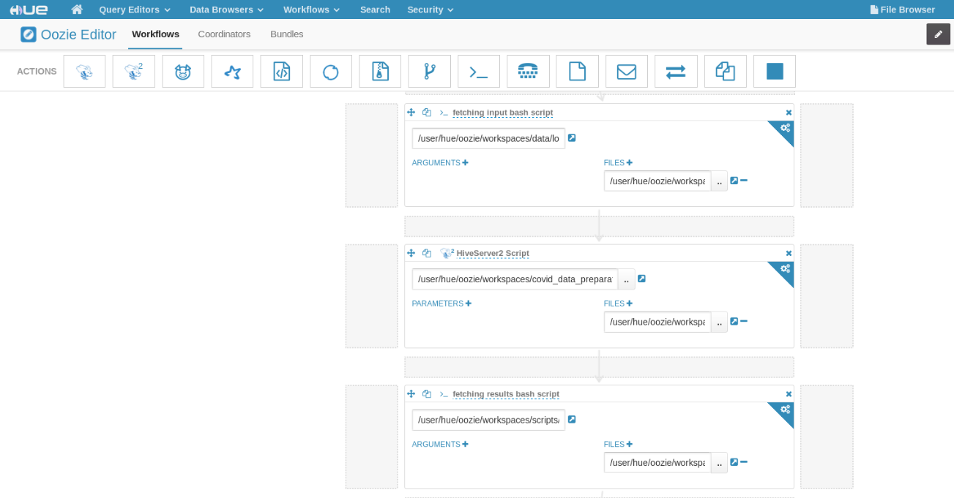
Oozie Workflow

Slide 12
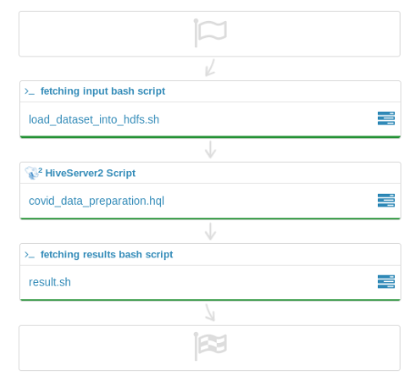
Oozie Workflow

Slide 13
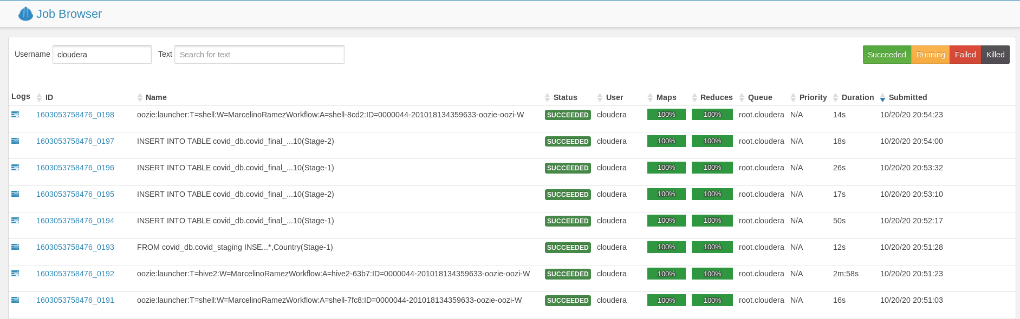
Oozie Workflow

Slide 14
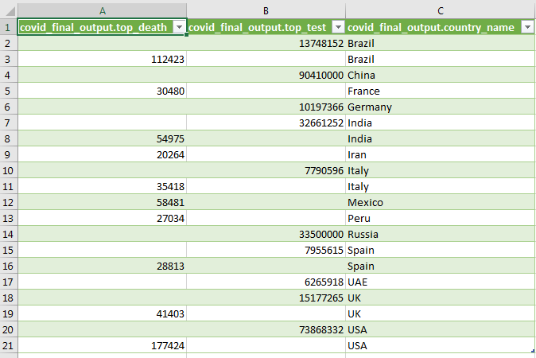
Visualization
1.Converting CSV data to excel

Slide 15
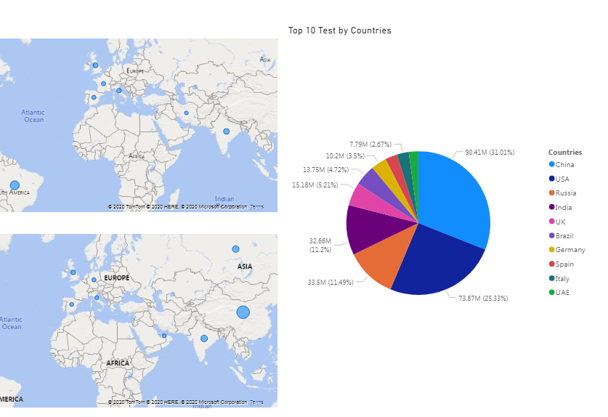
Visualization
2.Visualizing data By Power Bi

